Slide 1
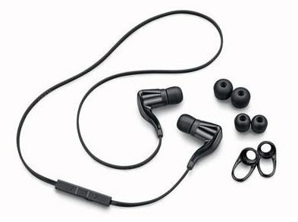
Music Study
Is there any correlation between number of credits and listening to music while studying? (Classical or non-classical)

Slide 2
Contents
Design the study
  Purpose of study & Population
  Research question / Null & Alternative Hypothesis
Collect the Data
  Sampling Methods
  Conducting the survey
  Raw collected Data
Describe the Data
  Excel what we found
  Graphs
Make inference
  What we found and put into words
  Requirements
Take Action

Slide 3
Design the study
Purpose of Study : We did the study to find out if there was a correlation between number of credits and the music people listened to while they study. We wondered if seniors had found it was helpful to listen to music or if it was distracting at BYUI
Research Question: Is there any correlation between number of credits of those who listen to music while studying? (Classical or Non-Classical)
H_{o} : Correlation between listening to music and the number of credits they have completed are independent.
H_{A} : Correlation between listening to music and the number of credits they have completed are not independent.
H_{o} : Correlation between listening to classical and non-classical music are independent.
H_{A} : Correlation between listening to classical and non-classical music are not independent.
Level of Significance α= 0.05

Slide 4
Collect the Data
We took a Simple Random Sample using RANDOM.org to select what buildings we would question the subjects in.
We used a systematic sampling method for the subjects. We placed the numbers 1-10 in RANDOM.org. 3 was the number it came up with so we asked every 3rd person in our human study.
We used a verbal human survey we asked the subject these questions and filled the survey out our selves
  Do you listen to music while you study?
  If so is it classical or non-classical?
  How many credits have you completed since you have started school?

Slide 5
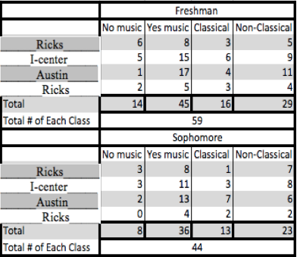
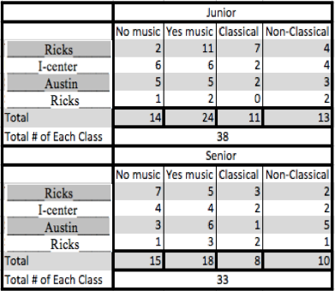
Raw data

Slide 6
Describe the data
Total Subjects: 174
Total that listen to music while they study: 123 (71%)
Total that do not listen to music: 51 (29%)
Total that listen to classical music: 48 (39%)
Total that listen to non-classical: 75 (61%)

Slide 7
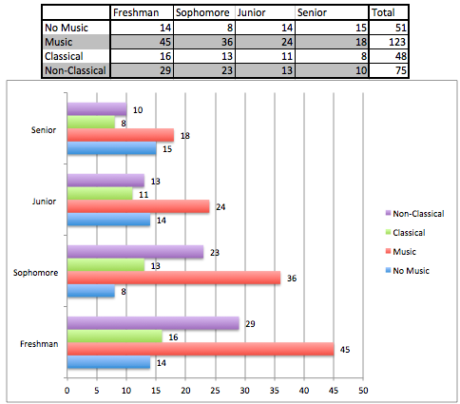
Describe the Data
Break up of Data in grades
Freshman
  No Music : 14
  Listen to music : 45
  Classical : 16
  Non-Classical : 29
Sophomore
  No music : 8
  Listen to music : 36
  Classical : 13
  Non-Classical : 23
Junior
  No music : 14
  Listen to music : 24
  Classical : 18
  Non-Classical : 13
Senior
  No music : 15
  Listen music : 18
  Classical : 8
  Non-Classical : 10

Slide 8
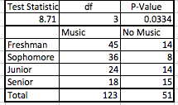
Make inference
Music / No Music
Test statistic : 8.71
Degree of freedom : 3
P-value 0.0334
α= 0.05 > 0.0334
There is sufficient evidence to suggest that the correlation between listening to music while studying and the number of credits completed are not independent.
We have found that as students get more credits or are further along in school listen to less music.

Slide 9
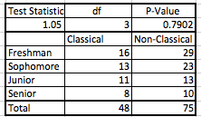
Make inference
Classical / Non-Classical
Test statistic : 1.05
Degree of freedom : 3
P-value 0.7902
α= 0.05 < 0.7902
There is insufficient evidence to suggest that the correlation between listening to classical and non-classical music are not independent.
We have found that there is not a correlation between amount of credits and whether they listen to classical or non classical music.

Slide 10
Take action
Freshman should consider the example of the senior in not listening to music while they study. Seniors have studied more and know what works.
We could submit this to the freshman orientation at the beginning of the school year or teachers that teach freshman to tell them the statistics and to help students gain better study habits.

Slide 11
Improvements for our study
Get some of our samples from student housing and the MC for a more diverse group of people. We asked all of our subjects in the halls of the buildings we were assigned. As individual classes got out we found that the grades would come out in groups, we would get two or three people from the same grade in a row.
We wish we would have known our study better when we began thinking it was a quantitative data study, when in fact it was categorical. We should have studied this ourselves instead of learning about it later in the semester.

